Slide 1

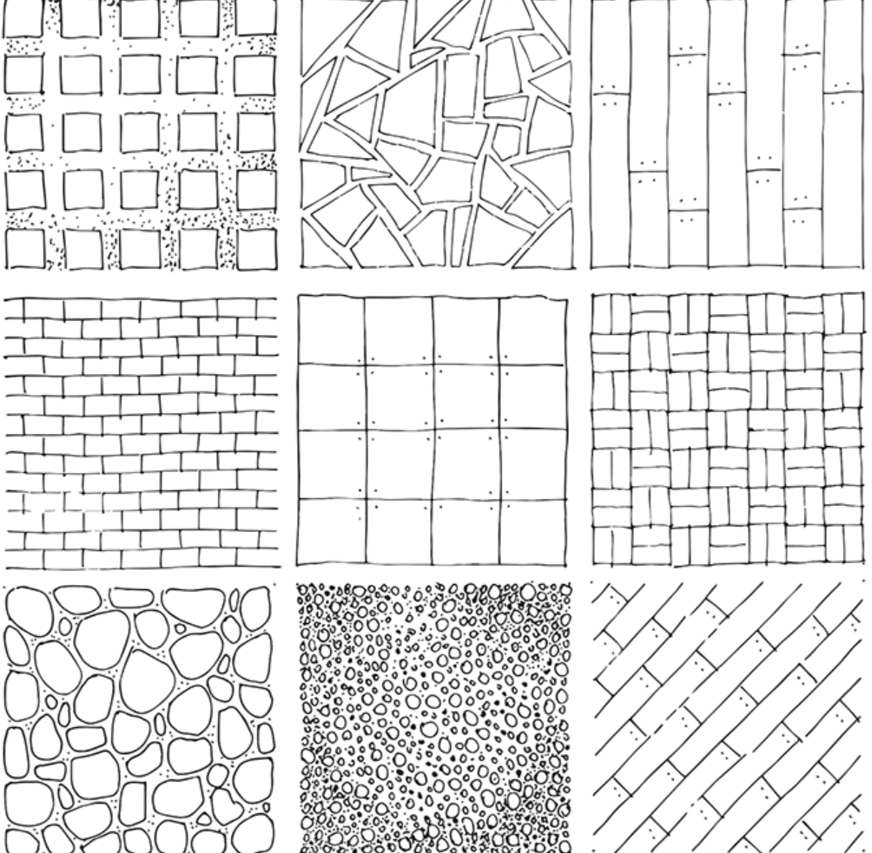
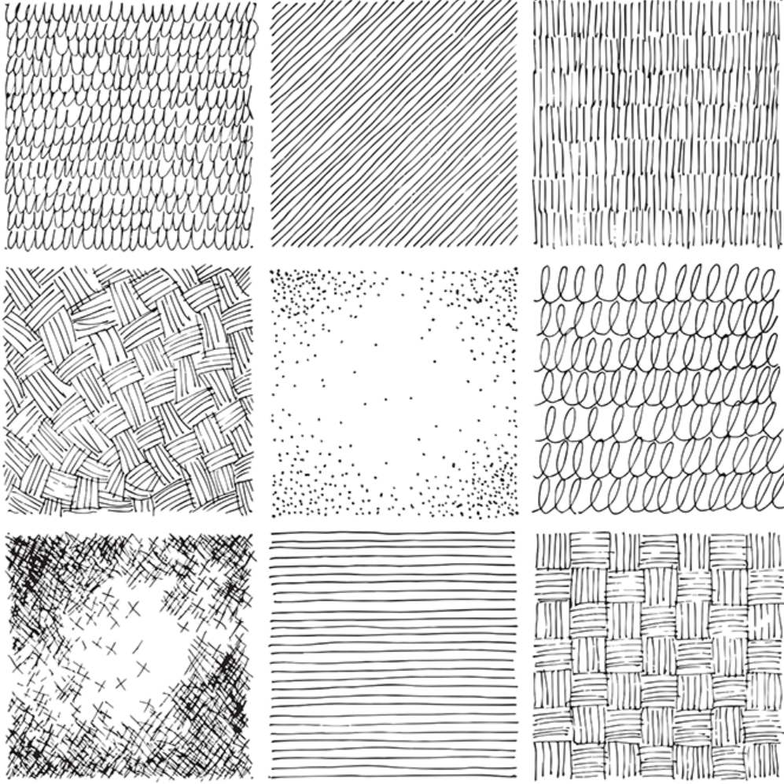
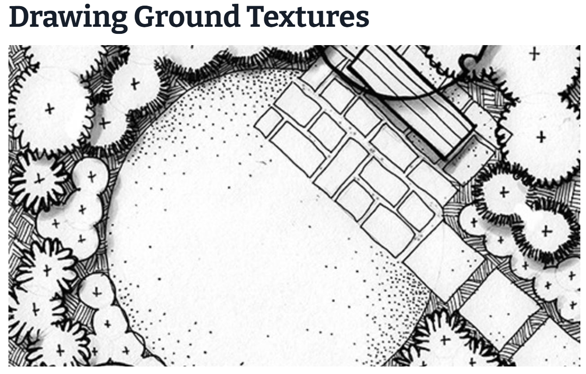
Individual Activity
Sketching exercise
- Draw in sketchbook and then share via e Portfolio

Slide 2

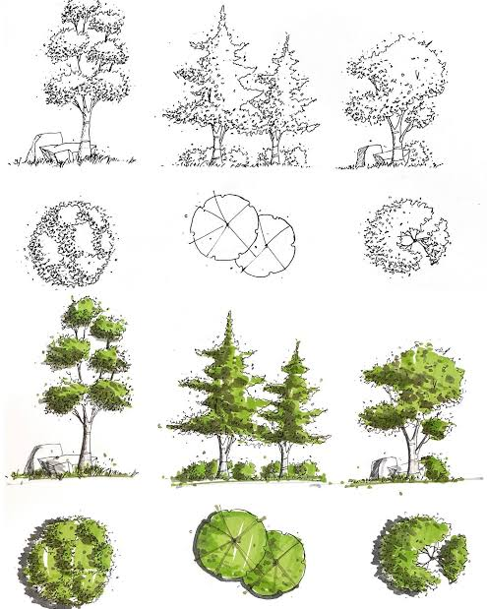
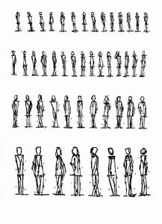
Individual Activity
Setup freehand sketch for perspective views with environmental context (interior and exterior)
Draw in sketchbook and then share via e Portfolio

Slide 3
Individual Activity
portfolio preparation; technical and software help

